Slide 1

Hand Written Model Using GAN
Done by,
Naveen K
210921205033
IT 3rd Year
Loyola Institute of Technology
Palanchur , Chennai-123

Slide 2

AGENDA
Problem Statement
Proposed System/Solution
System Development Approach
Algorithms & Deployment
Result
Conclusion
References

Slide 3

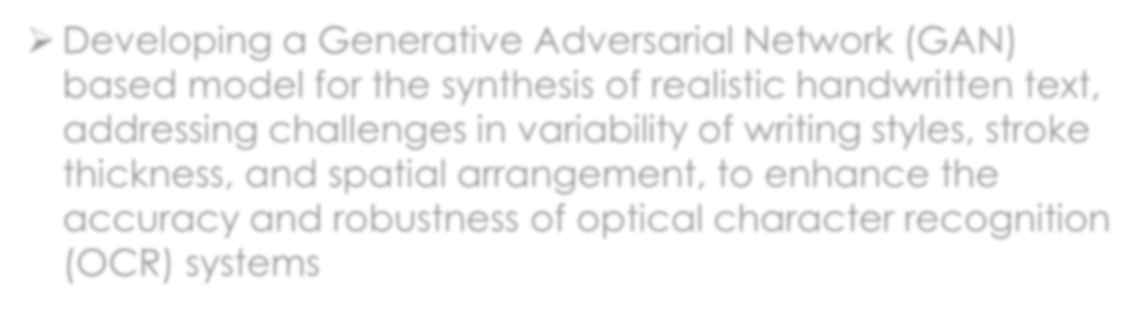
PROBLEM STATEMENT
Developing a Generative Adversarial Network (GAN) based model for the synthesis of realistic handwritten text, addressing challenges in variability of writing styles, stroke thickness, and spatial arrangement, to enhance the accuracy and robustness of optical character recognition (OCR) systems

Slide 4

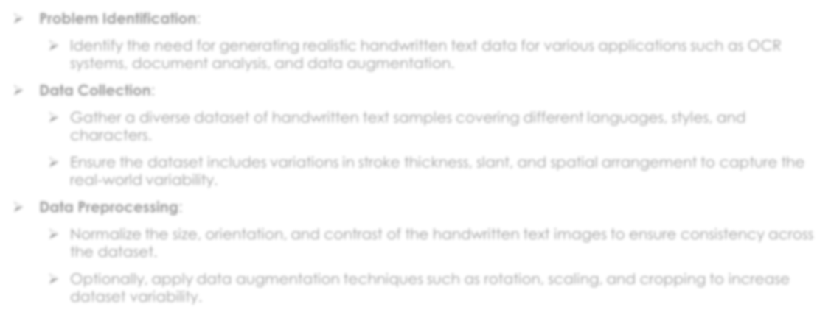
PROPOSED SOLUTION
Problem Identification:
Identify the need for generating realistic handwritten text data for various applications such as OCR
systems, document analysis, and data augmentation.
Data Collection:
Gather a diverse dataset of handwritten text samples covering different languages, styles, and
characters.
Ensure the dataset includes variations in stroke thickness, slant, and spatial arrangement to capture the real-world variability.
Data Preprocessing:
Normalize the size, orientation, and contrast of the handwritten text images to ensure consistency across
the dataset.
Optionally, apply data augmentation techniques such as rotation, scaling, and cropping to increase
dataset variability.

Slide 5
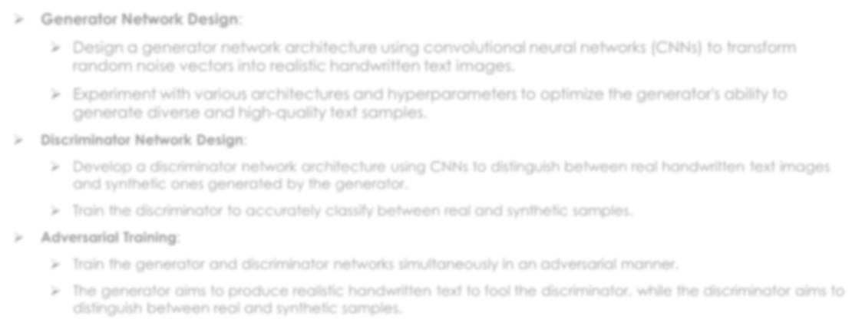
PROPOSED SOLUTION
Generator Network Design:
Design a generator network architecture using convolutional neural networks (CNNs) to transform
random noise vectors into realistic handwritten text images.
Experiment with various architectures and hyperparameters to optimize the generator's ability to generate diverse and high-quality text samples.
Discriminator Network Design:
Develop a discriminator network architecture using CNNs to distinguish between real handwritten text images
and synthetic ones generated by the generator.
Train the discriminator to accurately classify between real and synthetic samples.
Adversarial Training:
Train the generator and discriminator networks simultaneously in an adversarial manner.
The generator aims to produce realistic handwritten text to fool the discriminator, while the discriminator aims to
distinguish between real and synthetic samples.

Slide 6
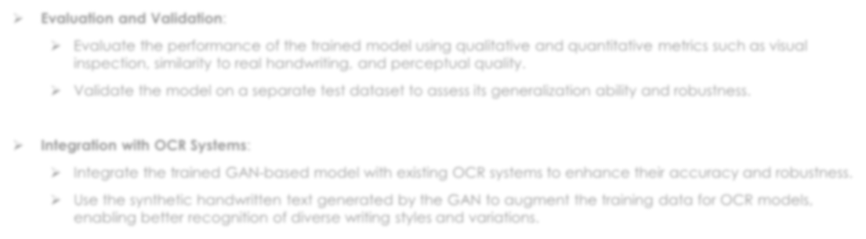
PROPOSED SOLUTION
Evaluation and Validation:
Evaluate the performance of the trained model using qualitative and quantitative metrics such as visual
inspection, similarity to real handwriting, and perceptual quality.
Validate the model on a separate test dataset to assess its generalization ability and robustness.
Integration with OCR Systems:
Integrate the trained GAN-based model with existing OCR systems to enhance their accuracy and robustness.
Use the synthetic handwritten text generated by the GAN to augment the training data for OCR models, enabling better recognition of diverse writing styles and variations.

Slide 7
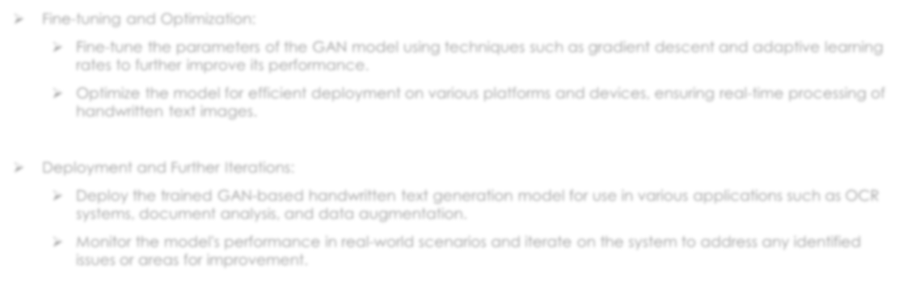
PROPOSED SOLUTION
Fine-tuning and Optimization:
Fine-tune the parameters of the GAN model using techniques such as gradient descent and adaptive learning
rates to further improve its performance.
Optimize the model for efficient deployment on various platforms and devices, ensuring real-time processing of handwritten text images.
Deployment and Further Iterations:
Deploy the trained GAN-based handwritten text generation model for use in various applications such as OCR
systems, document analysis, and data augmentation.
Monitor the model's performance in real-world scenarios and iterate on the system to address any identified issues or areas for improvement.

Slide 8

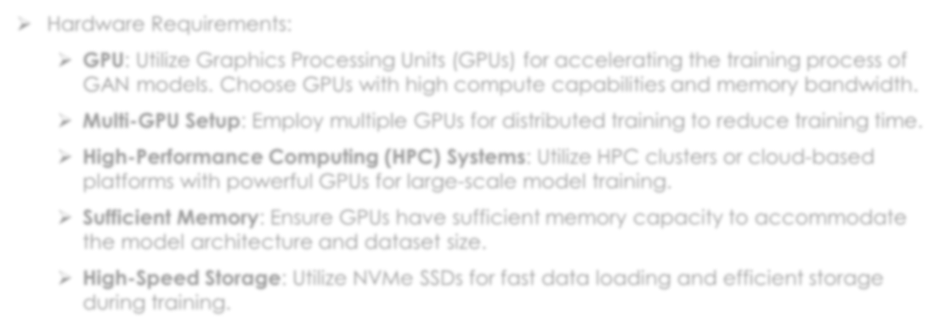
SYSTEM APPROACH
Hardware Requirements:
GPU: Utilize Graphics Processing Units (GPUs) for accelerating the training process of GAN models. Choose GPUs with high compute capabilities and memory bandwidth.
Multi-GPU Setup: Employ multiple GPUs for distributed training to reduce training time.
High-Performance Computing (HPC) Systems: Utilize HPC clusters or cloud-based
platforms with powerful GPUs for large-scale model training.
Sufficient Memory: Ensure GPUs have sufficient memory capacity to accommodate
the model architecture and dataset size.
High-Speed Storage: Utilize NVMe SSDs for fast data loading and efficient storage
during training.

Slide 9
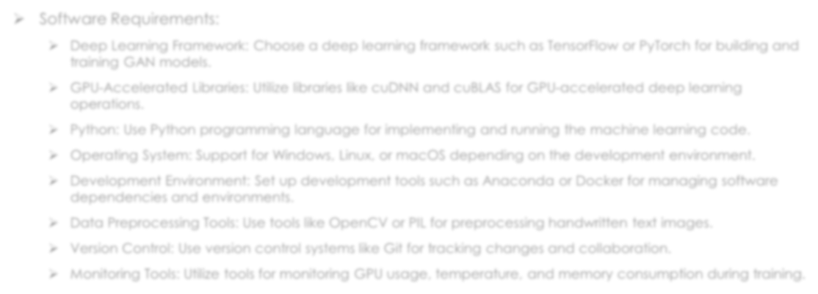
SYSTEM APPROACH
Software Requirements:
Deep Learning Framework: Choose a deep learning framework such as TensorFlow or PyTorch for building and
training GAN models.
GPU-Accelerated Libraries: Utilize libraries like cuDNN and cuBLAS for GPU-accelerated deep learning
operations.
Python: Use Python programming language for implementing and running the machine learning code.
Operating System: Support for Windows, Linux, or macOS depending on the development environment.
Development Environment: Set up development tools such as Anaconda or Docker for managing software
dependencies and environments.
Data Preprocessing Tools: Use tools like OpenCV or PIL for preprocessing handwritten text images.
Version Control: Use version control systems like Git for tracking changes and collaboration.
Monitoring Tools: Utilize tools for monitoring GPU usage, temperature, and memory consumption during training.

Slide 10

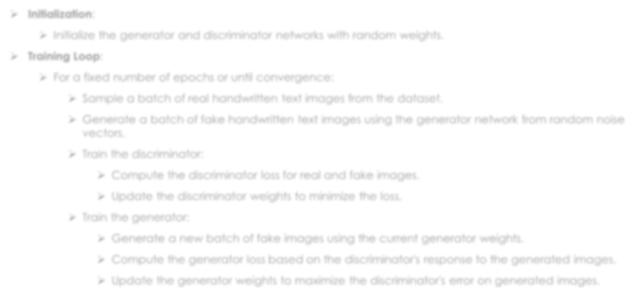
ALGORITHM
Initialization:
Initialize the generator and discriminator networks with random weights.
Training Loop:
For a fixed number of epochs or until convergence:
Sample a batch of real handwritten text images from the dataset.
Generate a batch of fake handwritten text images using the generator network from random noise vectors.
Train the discriminator:
Compute the discriminator loss for real and fake images.
Update the discriminator weights to minimize the loss.
Train the generator:
Generate a new batch of fake images using the current generator weights.
Compute the generator loss based on the discriminator's response to the generated images.
Update the generator weights to maximize the discriminator's error on generated images.

Slide 11

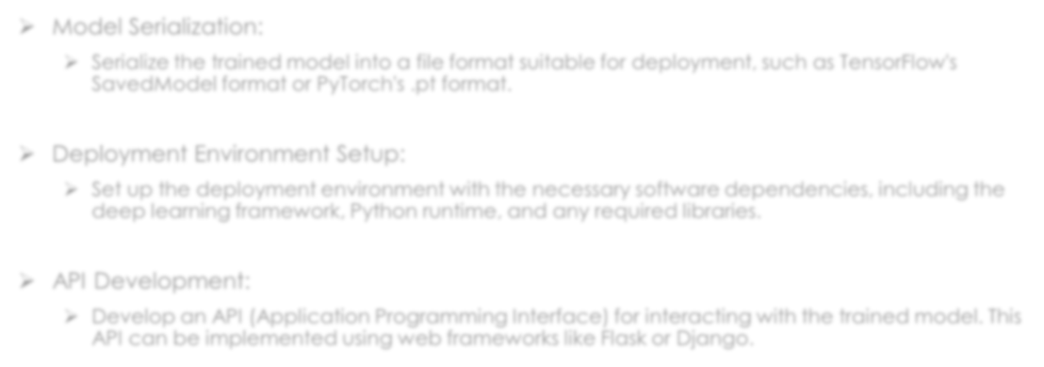
DEPLOYMENT
Model Serialization:
Serialize the trained model into a file format suitable for deployment, such as TensorFlow's SavedModel format or PyTorch's .pt format.
Deployment Environment Setup:
Set up the deployment environment with the necessary software dependencies, including the deep learning framework, Python runtime, and any required libraries.
API Development:
Develop an API (Application Programming Interface) for interacting with the trained model. This API can be implemented using web frameworks like Flask or Django.

Slide 12
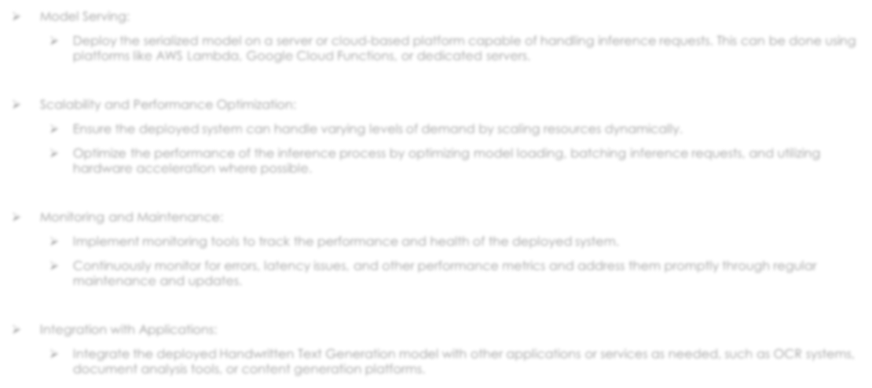
DEPLOYMENT
Model Serving:
Deploy the serialized model on a server or cloud-based platform capable of handling inference requests. This can be done using
platforms like AWS Lambda, Google Cloud Functions, or dedicated servers.
Scalability and Performance Optimization:
Ensure the deployed system can handle varying levels of demand by scaling resources dynamically.
Optimize the performance of the inference process by optimizing model loading, batching inference requests, and utilizing
hardware acceleration where possible.
Monitoring and Maintenance:
Implement monitoring tools to track the performance and health of the deployed system.
Continuously monitor for errors, latency issues, and other performance metrics and address them promptly through regular
maintenance and updates.
Integration with Applications:
Integrate the deployed Handwritten Text Generation model with other applications or services as needed, such as OCR systems, document analysis tools, or content generation platforms.

Slide 13

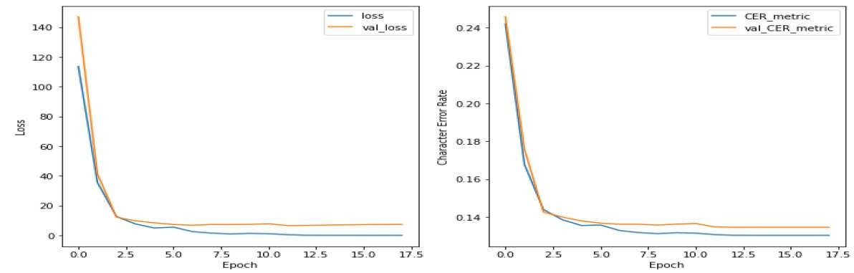
RESULT

Slide 14

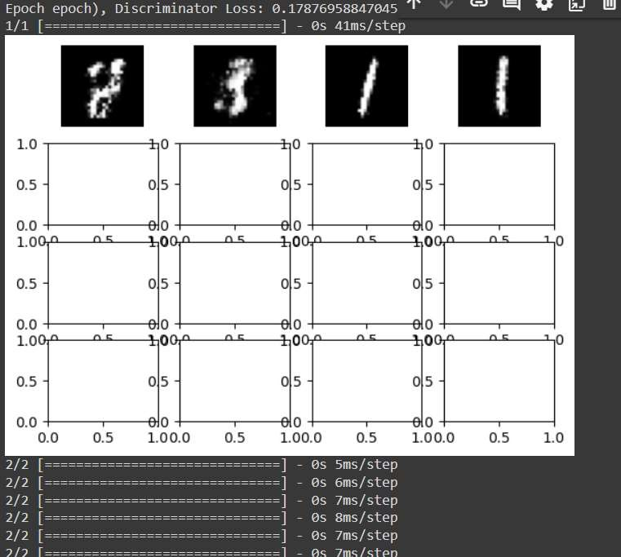
RESULT

Slide 15

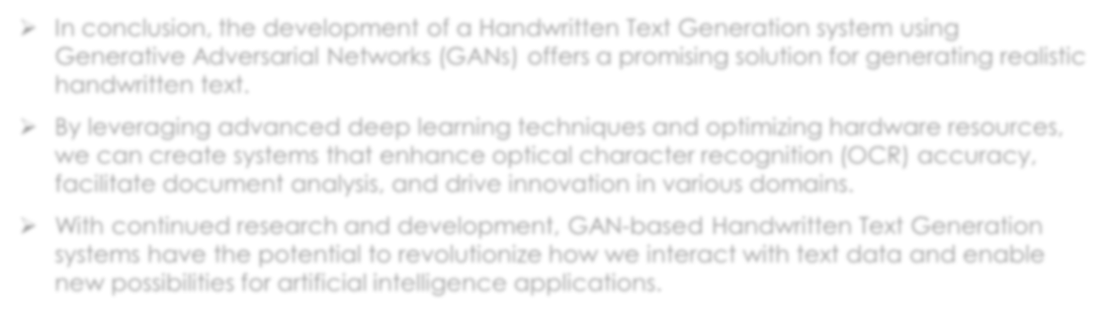
CONCLUSION
In conclusion, the development of a Handwritten Text Generation system using Generative Adversarial Networks (GANs) offers a promising solution for generating realistic handwritten text.
By leveraging advanced deep learning techniques and optimizing hardware resources, we can create systems that enhance optical character recognition (OCR) accuracy, facilitate document analysis, and drive innovation in various domains.
With continued research and development, GAN-based Handwritten Text Generation systems have the potential to revolutionize how we interact with text data and enable new possibilities for artificial intelligence applications.

Slide 16

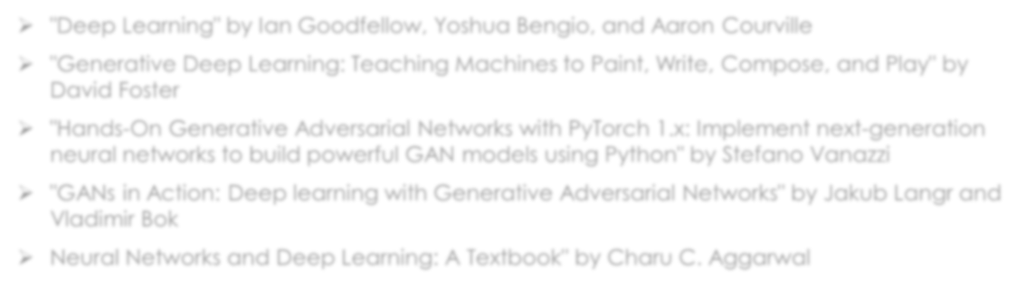
REFERENCES
"Deep Learning" by Ian Goodfellow, Yoshua Bengio, and Aaron Courville
"Generative Deep Learning: Teaching Machines to Paint, Write, Compose, and Play" by
David Foster
"Hands-On Generative Adversarial Networks with PyTorch 1.x: Implement next-generation
neural networks to build powerful GAN models using Python" by Stefano Vanazzi
"GANs in Action: Deep learning with Generative Adversarial Networks" by Jakub Langr and
Vladimir Bok
Neural Networks and Deep Learning: A Textbook" by Charu C. Aggarwal

